Slide 1
2020-21 Budget
Presented to the Board of Trustees on
june 08, 2021

Slide 2
Key Budget Information for 2021-22 Budget
Recommended Certification Status: Positive
Enrollment is based on estimated 20/21CBEDS growth at 794
Projected average daily attendance (ADA) ratio is estimated at 93.24%
Deficit spending is projected, but Basic Aid Supplement is not budgeted. Projected Basic Aid Supplemental amount for 20/21 is $2,111,834 million.
Workers Compensation increase of $27,730 (400% above prior year)
STRS/PERS increase of $26,461 in 21/22, $144k in 22/23 (82% increase above prior year)
Increase in contributions to restricted programs, decrease in District Reserves

Slide 3
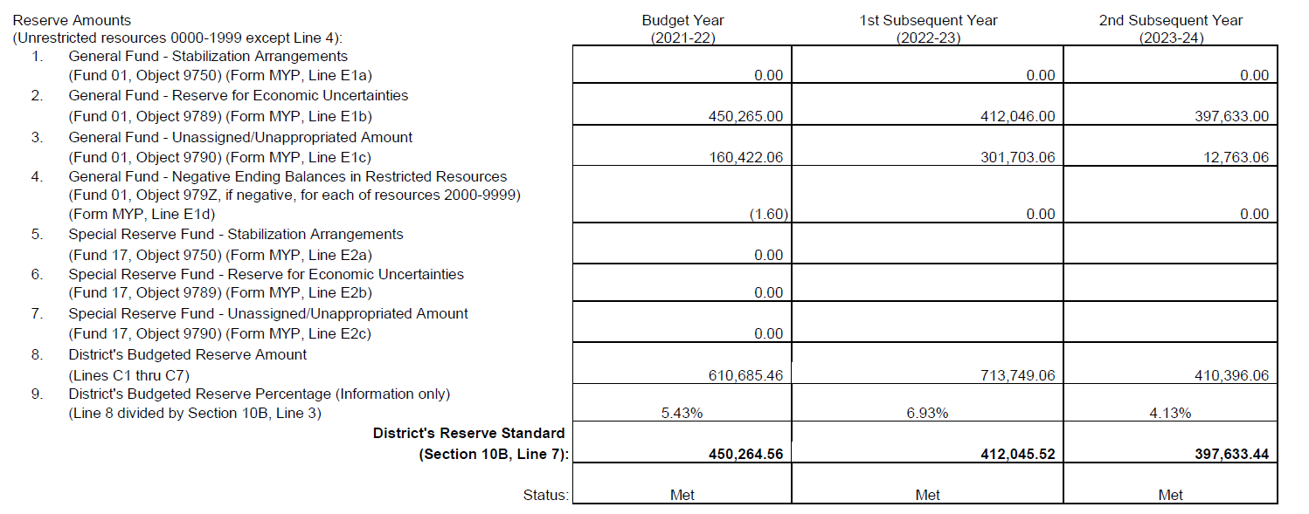
The District is recommending that the Board approve a Positive Certification
This means that the District is able to meet the required minimum reserve level in all three years

Slide 4
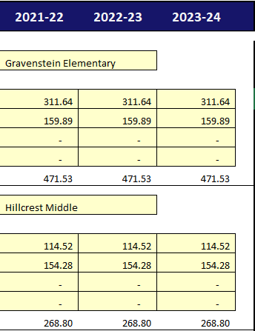
ADA & Enrollment ratio
The enrollment estimate for CBEDS day is estimated at 794
Average Daily Attendance is estimated at 740.33
The estimate ADA percentage used in the budget is 93.24%
Unduplicated Pupil Percentage used for Title I funding is estimated at 28.96%

Slide 5
COLA
LCFF revenue is based on a 5.07 COLA. This COLA represents:
Unfunded 2020-21 prior year COLA of 2.31 %
Estimated 2021-22 current year COLA of 1.7 %
Addition of 1.0 % from the Governor
COLA is not added evenly to all funding. Below is a breakdown of the different COLA’s applied to the different 2021-22 revenue sources.

Slide 6
Salaries & benefits Ratio to unrestricted General Fund Expenditures
Expenditures related to COVID expected to decrease in 2023-24 once funding decreases. This pushes our Salary and Benefits expenditure above our historical average.

Slide 7
One-time revenues contributions to restricted
One-time revenues are being utilized for ongoing expenditures:
Increased FTE of classified staff needed for differentiated instruction for the Enrich! program.
The 1.5 million reserve assigned for program stabilization has been decreased in the current year to meet the Minimum Reserve for Economic Uncertainty and removed entirely in the projection years.
Increase contribution to resource 6500 for Special Education program reflects:
Increased staffing to support Special Education activities within the District
1 student placed in SCOE programs
2 District students placed in out of District SDC classrooms
The required 3% contribution to Routine Restricted Maintenance, (Rs 8150) has been budgeted in all 3 years.

Slide 8
Deficit spending
Deficit spending is projected in all three years due to:
COLA not keeping up with the increases in STRS & PERS
STRS rates% Increase from PY $ PERS Rates % Increase from PY $
2021-22 is 16.92 % 60,852 2021-22 is 22.91 % 42,065
2022-23 is 19.10 % 116,793 2022-23 is 26.10 % 49,521
2023-24 is 19.10 % 13,770 2023-24 is 27.10 % 22,045
Workers Compensation increased 400% from prior year ($26k increase)
Ongoing transfers to Fund 14 for Deferred Maintenance (25.2k) and Fund 13, the Cafeteria Fund (37k)
Additional Classified support staff necessary for the Enrich! program for all District students
Basic Aid Supplemental is not budgeted. Estimated funding for all three years is 4.2 million
Donation revenue is not budgeted until received for current or subsequent years
Tax revenue is conservatively budgeted to stay flat for all three years and is based on 2020-21 P-2 estimates of 3.2 million

Slide 9
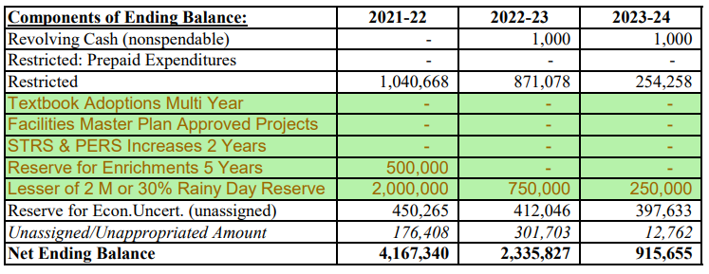
Reserve assignments for fiscal stability

Slide 10
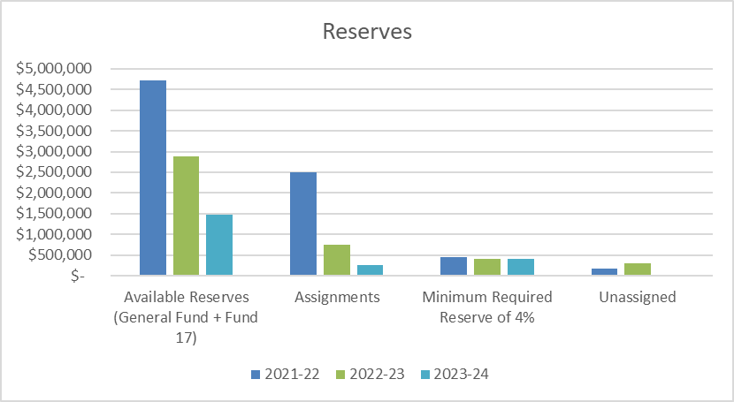

Slide 11
Long-Term Debt
GUSD does have Long-term debt in the form of our General Obligation Bond & payments are increasing each year.
2021-22 is $388,196
2022-23 is $396,542
2023-24 is $408,233
The increase is due to the General Obligation Bond amortization and the data used here is the 2019-20 Audit Report. The General Obligation Bond payment is paid from Fund 51.

Slide 12
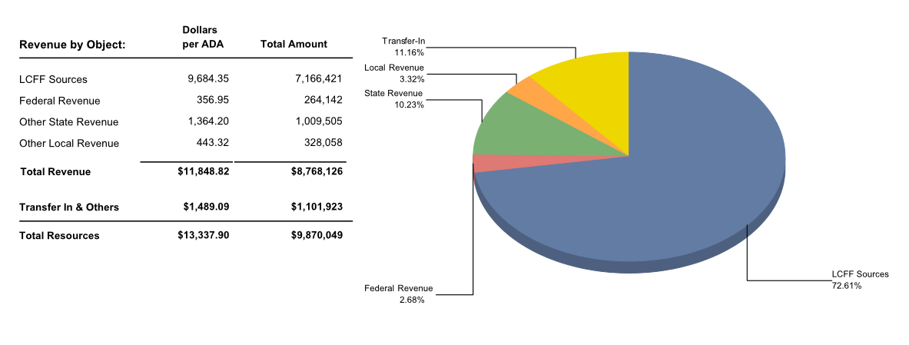
General Fund Revenue Sources

Slide 13
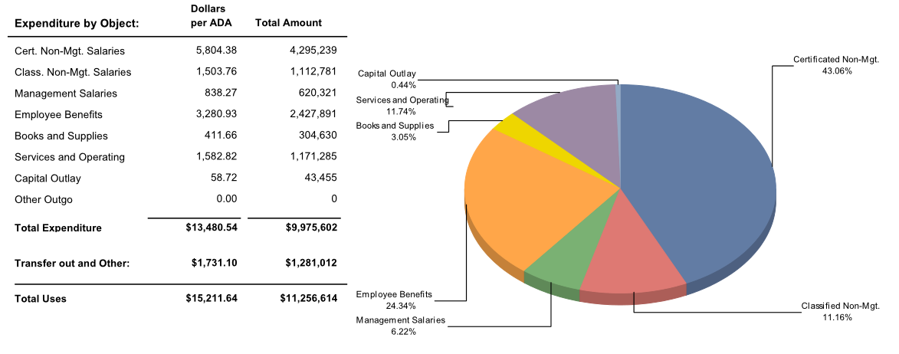
General Fund Expenditures

Slide 14
OPEB Change of superintendent or cbo
GUSD does offer post employee benefits other than pensions, OPEB.
See the GUTA contract for details.
The personnel change for the positions of superintendent or CBO in the last twelve months includes the hiring of Katie Anderson on May 26, 2021.

Slide 15
Questions?

