Slide 1
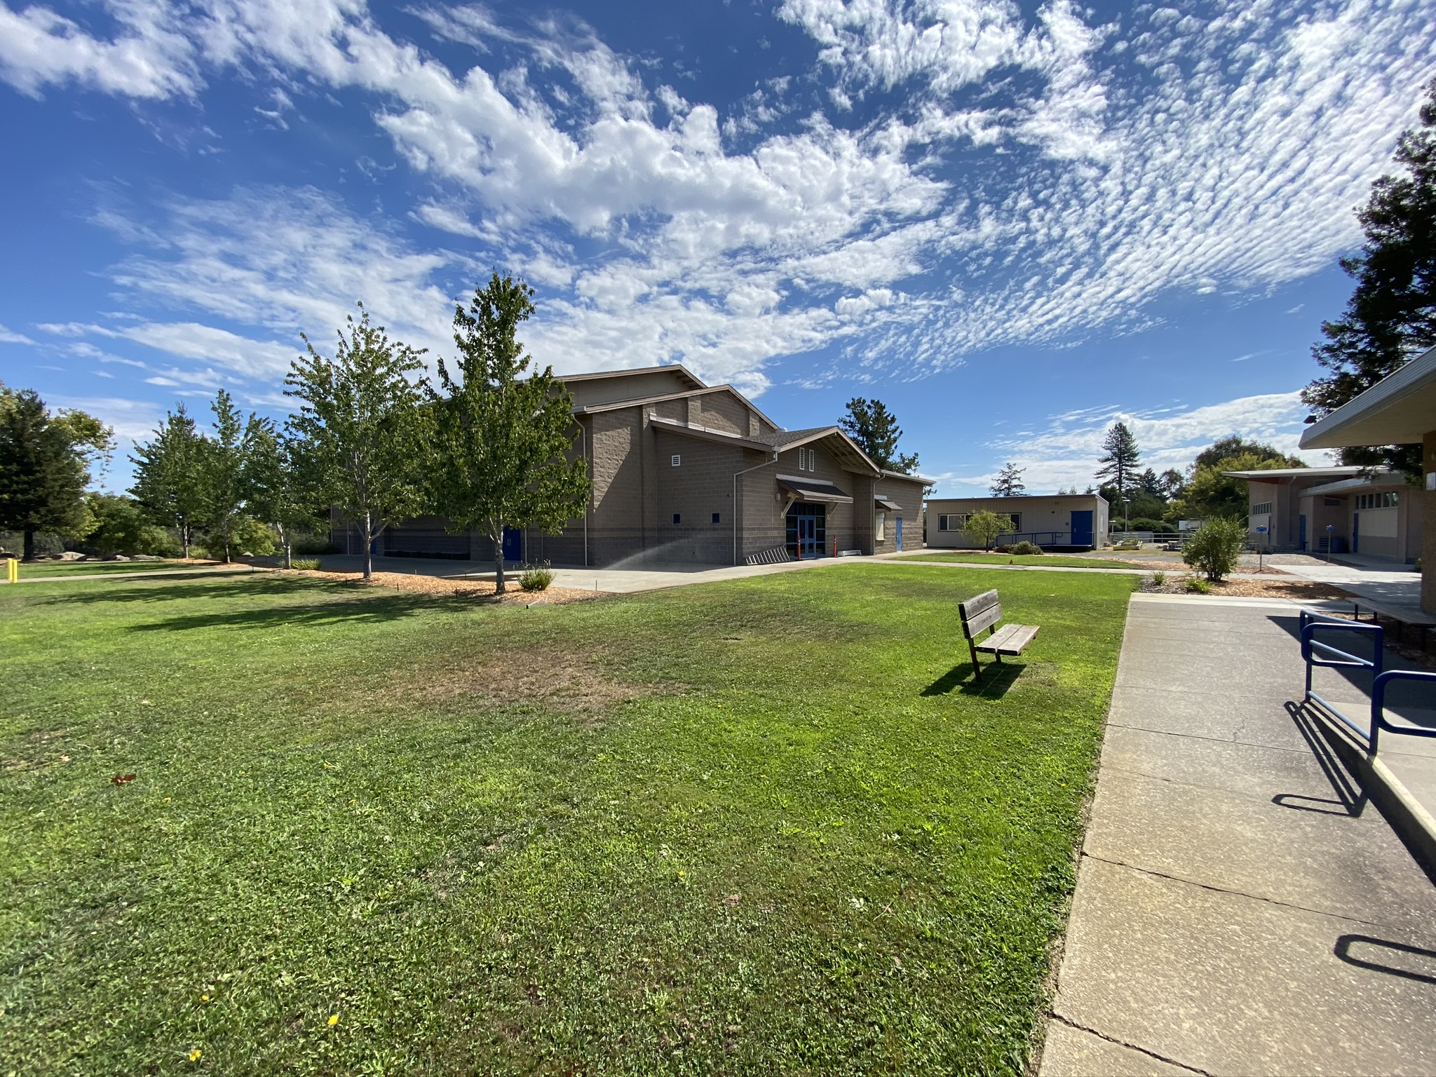
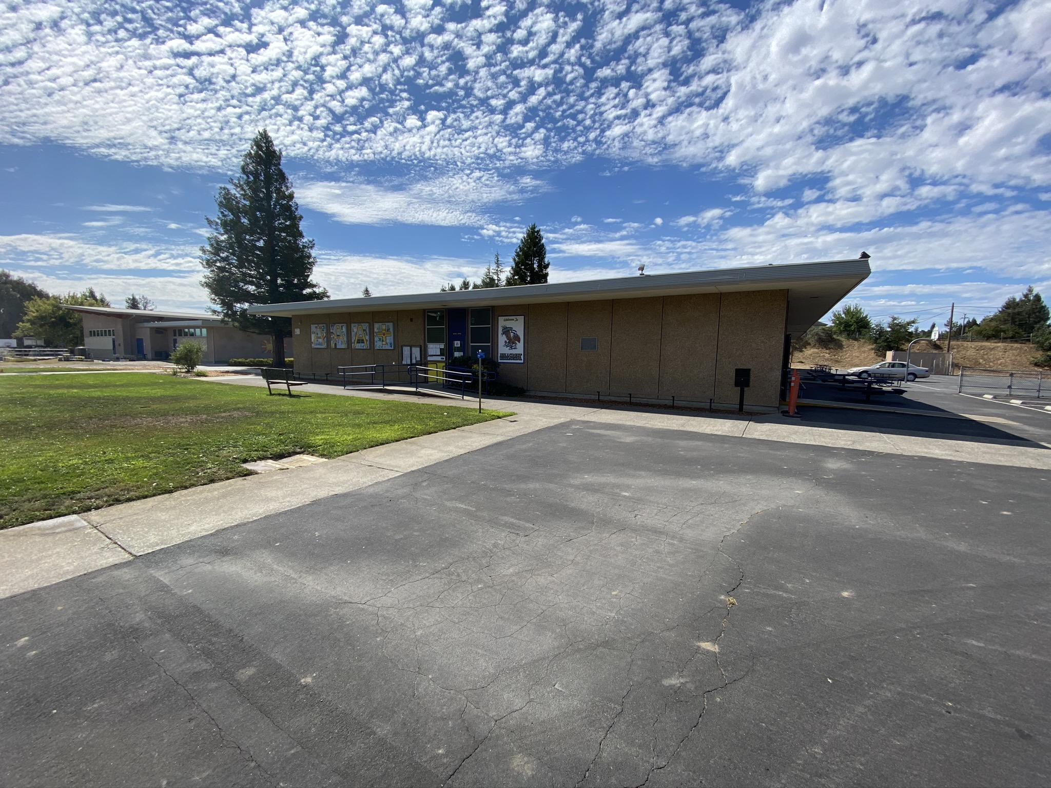
HILLCREST MIDDLE SCHOOL
HEAT MITIGATION STUDY
Prepared for Gravenstein Union School District
December 2020
QKA Job number: 1889.00

Slide 2
AGENDA & GOAL
Introductions & Roles
Overview Of Issue
Recommendations
Covid-19 Impacts
Potential Scope Packages and Cost Estimates
Conclusions & Next Steps
GOAL:
Provide District Guidance on Likely Scope of Project for Implementation

Slide 3
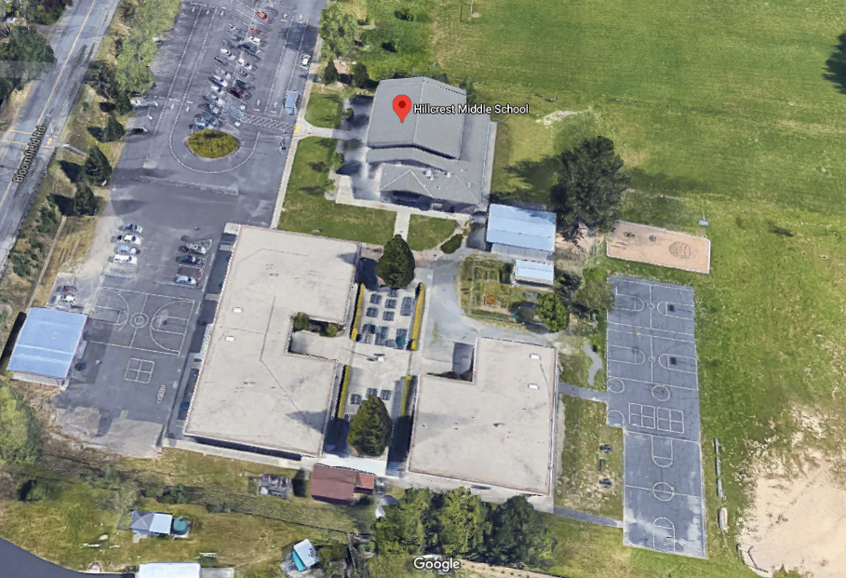
Campus Overview

Slide 4
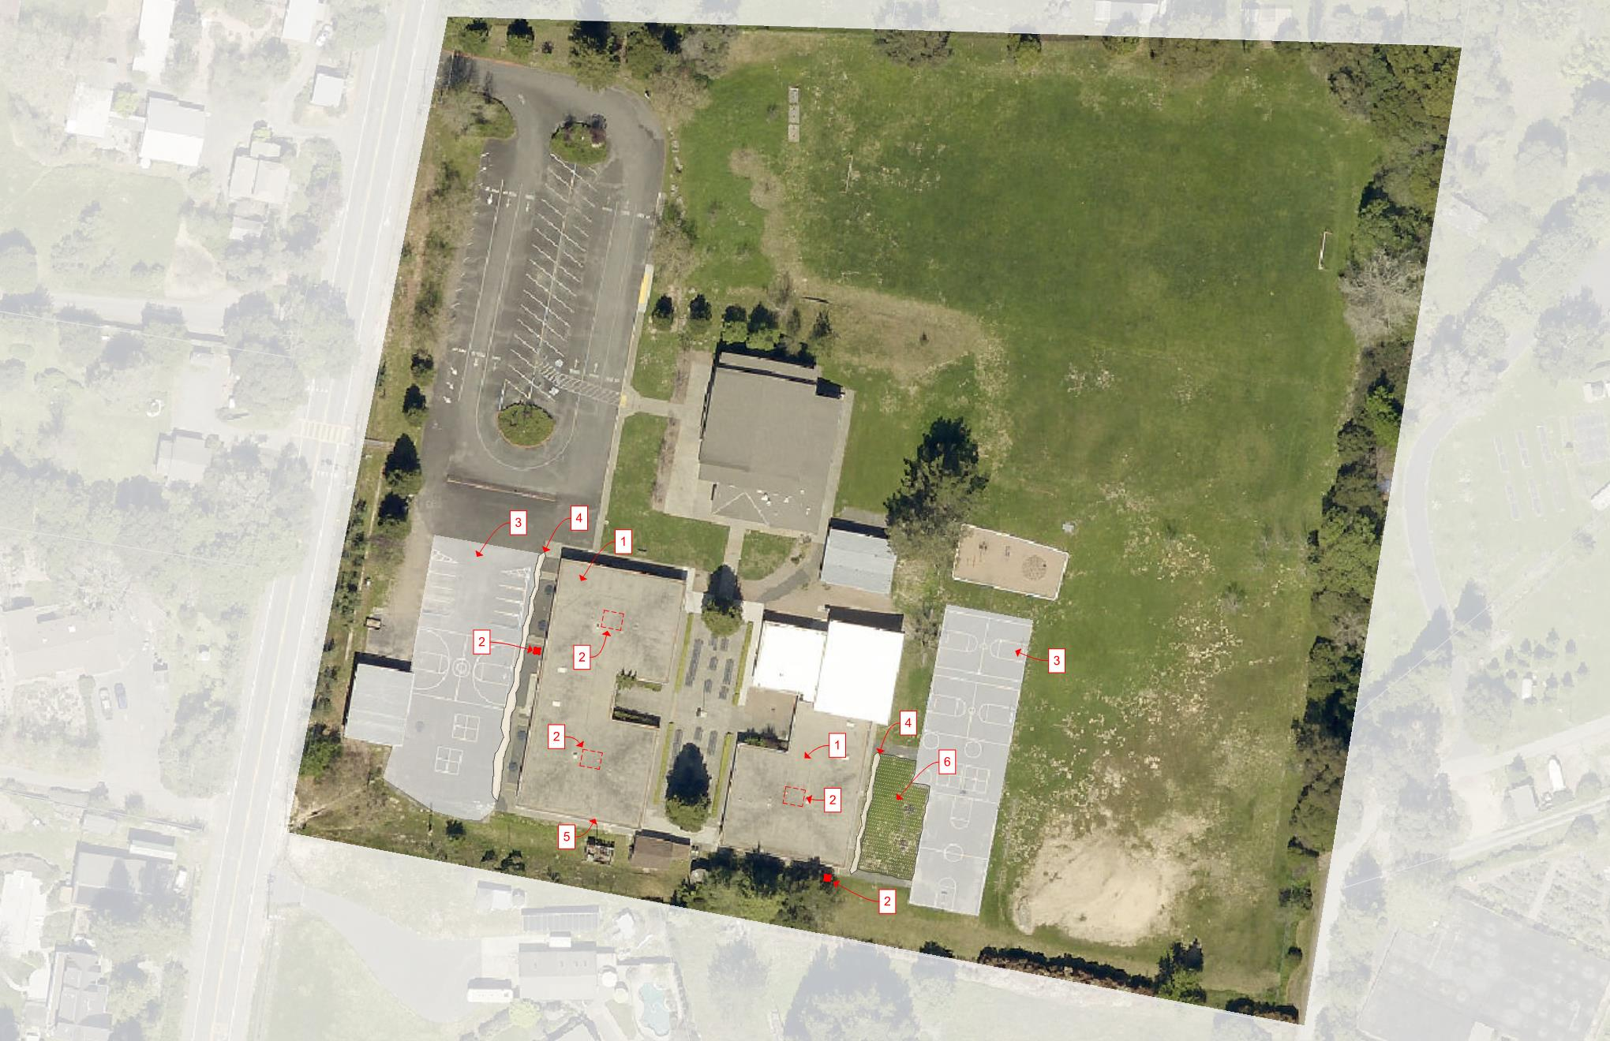
RECOMMENDATIONS – AERIAL VIEW
NEW HIGH REFLECTIVE ROOF AND INSULATION
MECHANICAL IMPROVEMENTS (4 LEVELS)
HEAT REFLECTIVE COATINGS FOR THE AC PAVING AREAS
PLANTING ALONG THE EAST AND WEST WALKWAY
ENVELOPE IMPROVEMENTS (2 LEVELS)
IRRIGATION FOR WEST SIDE HILL
NORTH

Slide 5
RECOMMENDATIONS – SECTION VIEW
NEW HIGH REFLECTIVE ROOF AND INSULATION.
DETAILED IN THE RAMP REPORT FROM GARLAND
ROOF IS LIKLEY IN NEED OF REPLACEMENT REGARDLESS OF HEAT MITIGATION EFFORT
MECHANICAL IMPROVEMENTS (3 LEVELS)
LEVEL 1
TEST AND REPROGRAM EXISTING HVAC SYSTEM, NIGHT FLUSH AND REPAIR AS NEEDED
LEVEL 2
VRF OR PACKAGE UNITS (MAY HAVE ELECTRICAL IMPACT)
LEVEL 3
ADDITIONAL FILTRATION FOR IMPROVED IAQ
LEVEL 4
FULL AC RETROFIT AND ELECTRICAL SERVICE UPGRADE
HEAT REFLECTIVE COATINGS FOR THE AC PAVING AREAS
INCLUDES THE PARKING AREA THE EAST AND THE BASKETBALL COURTS TO THE WEST
THIS WILL REDUCE THE AMOUNT OF HEAT COMING INTO THE BUILDINGS FROM ADJACENT PAVING AREAS
PLANTING ALONG THE EAST AND WEST WALKWAY
WOULD HELP REDUCE THE HEAT GAIN FROM THE EARLY MORNING OR AFTERNOON SUN.
NEED TO BE MINDFUL OF SEPTIC SYSTEM ON WEST SIDE
CONSIDER MAINTENANCE OF THE PLANT SPECIES
LIKELY NEED TO BE POTTED
ENVELOPE IMPROVEMENTS
LEVEL 1
RETROFIT SOLUTIONS (CAN BE DONE IN STAGES)
EXTERIOR PAINTING
LIGHT COLORS REFLECT MORE HEAT
RETROFIT INSULATION
CONFIRM EXISTING BUILDINGS HAVE NO INSULATION
A RETROFIT FOAM INJECTION SOLUTION
LEVEL 2
COMPREHENSIVE RECLADDING
REMOVE/REPLACE EXISTING STONE/STUCCO CLADDING
INSULATE WALLS
CAVITY AND/OR EXTERIOR INSULATION SYSTEMS
THERMALLY IMPROVED WINDOWS & LOW-E GLAZING
REDUCE HEAT GAIN THROUGH FRAME AND GLAZAING
IRRIGATION FOR WEST SIDE HILL
HELP REDUCE HEAT GAIN FROM SOIL
1
5
2
3
4
6

Slide 6
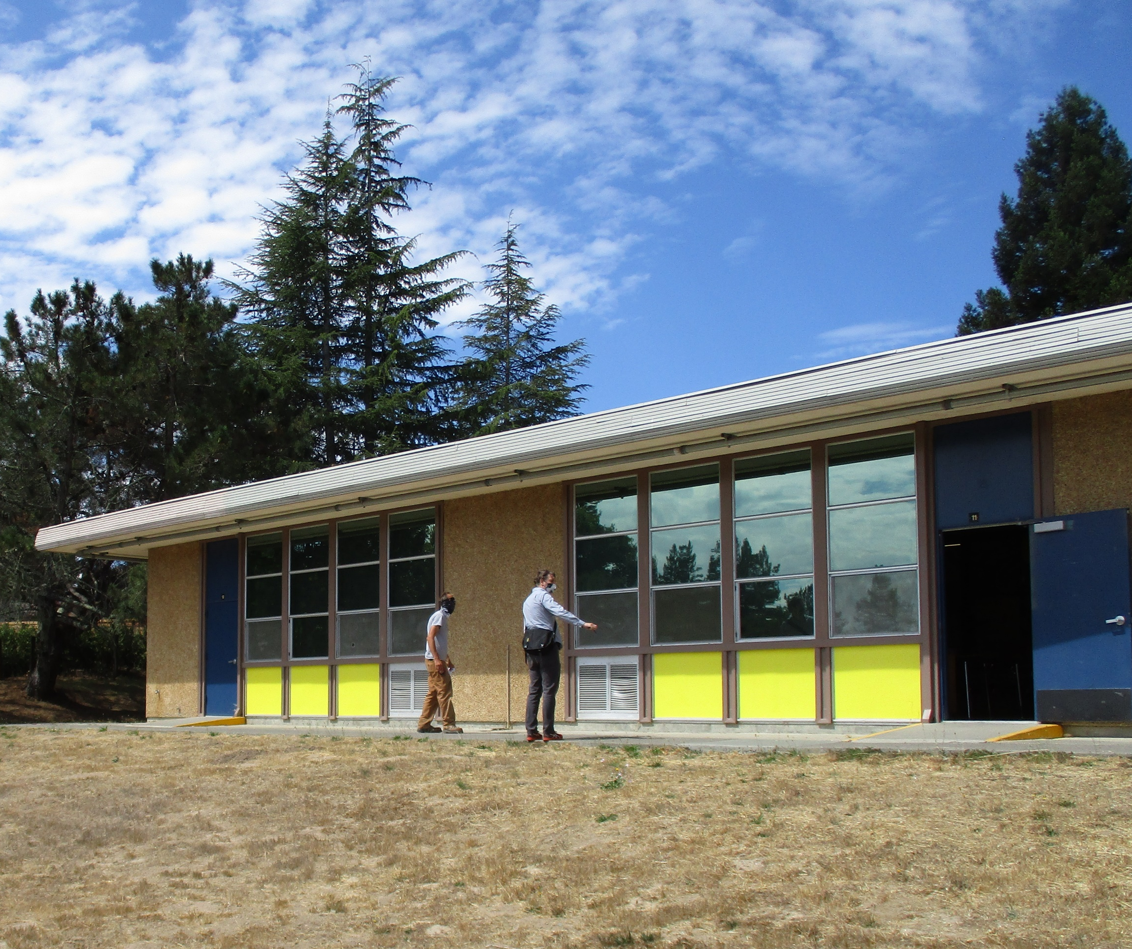
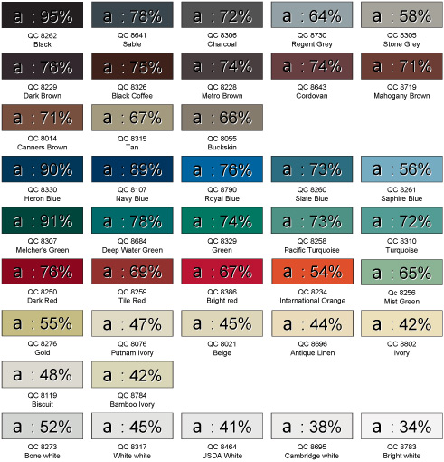
RECOMMENDATIONS – ENVELOPE
Envelope Review
Existing heat gain from surfaces are impacted by the orientation, East & West, having the majority of heat gains in the morning and afternoon. The paint colors, added rock mass walls, and paving surfaces around the building all exacerbate the heat gain and heat transfer to the conditioned space. Site visits occurred on a sunny summer day with an outside air temperature of 86F but the surfaces of the building were exceptionally higher based on the type of material and the paint color. The mass wall surfaces was measured with a thermal temperature gun at 123F in the sun and 106F in the shade under the overhangs. The yellow painted uninsulated wall panels were measured at 119F and the warmest of all surfaces, the blue painted doors, were measured at 136F. All of these surfaces are absorbing and radiating heat into the interior space. The blacktop on the West side of the campus right next to the classrooms was measured at 130F, nearly 50F higher than the air around the building.
Recommendations:
Paint surfaces a light color with high reflectivity, avoid dark surfaces or limit them to areas that are well shaded.
Paint asphalt surfaces near the building with high albedo pavement surface paint to reduce heat gain. Sample products: https://neyra.com/products/sealers/sunshield/
Plant trees or vines in planter boxes to shade the structure on the East & West facades. Since the area to the East is part of the septic leach field and to the West is paved surface tree planting is limited. Climbing summer vines such as string beans, hops, or other seasonal vine can easily be managed in planter boxes and allowed to climb on trellis or shade structure.
106 F
123 F
119 F
136 F

Slide 7
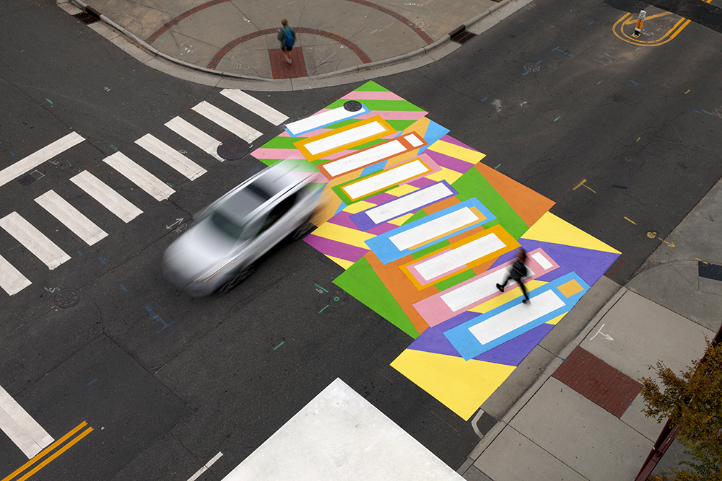
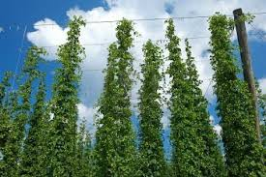
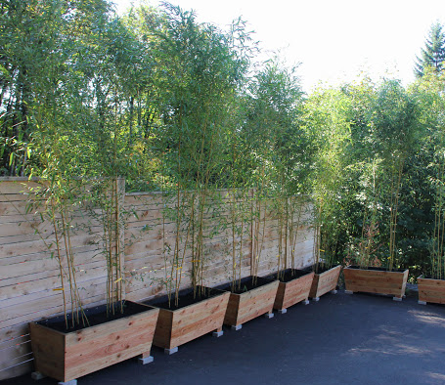
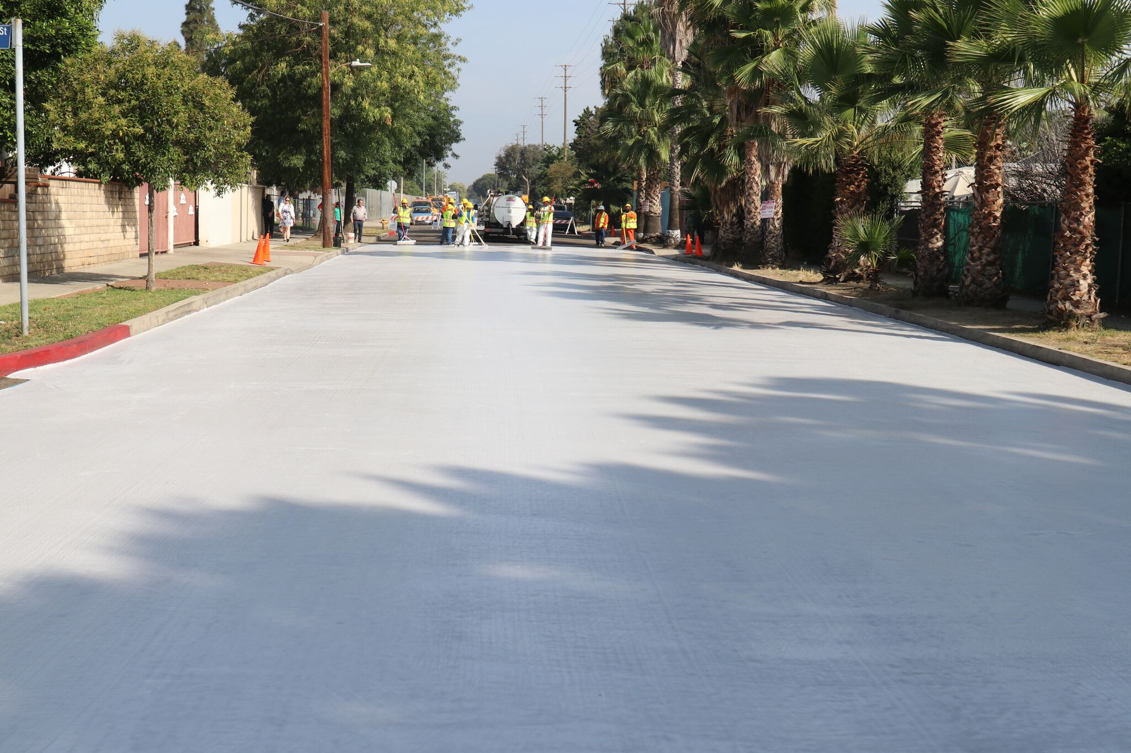
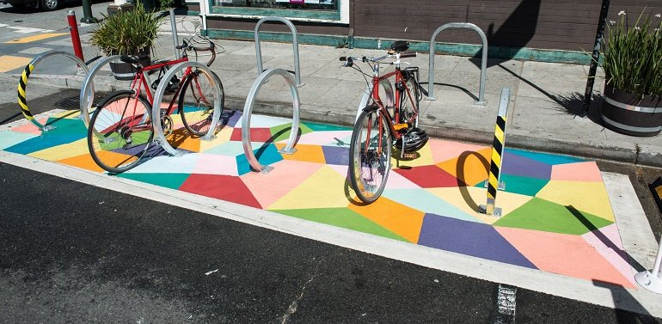
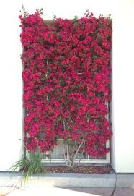
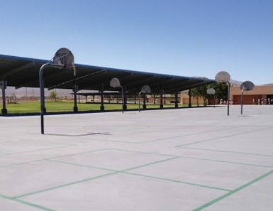
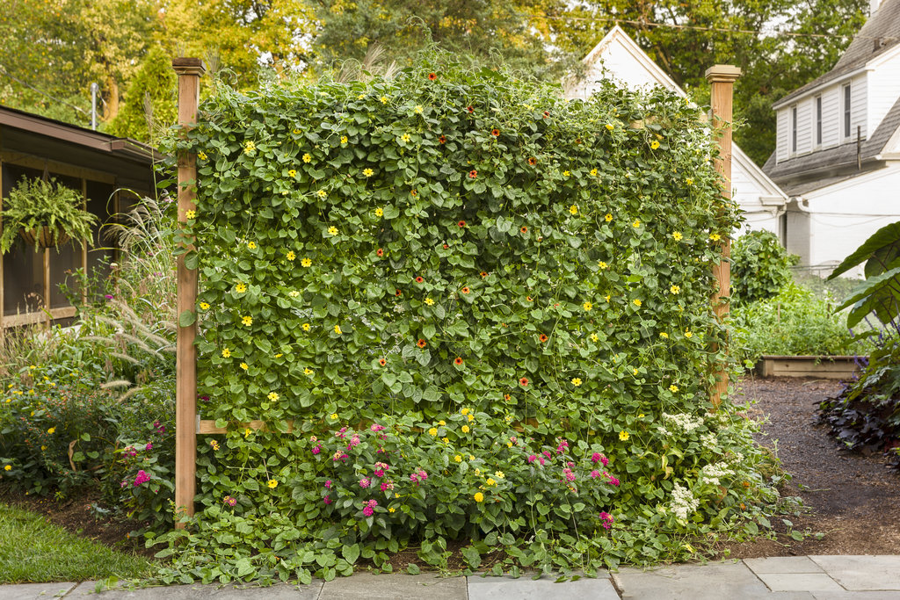
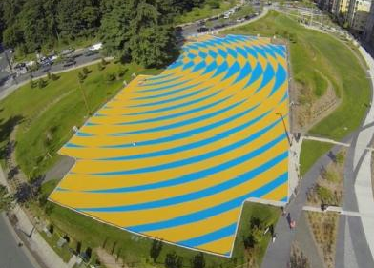
RECOMMENDATIONS – ENVELOPE
Hops
Bamboo
Bougainnvillea
Black-Eyed Susan
Examples of Cool Pavement Coatings
Examples of Cool Planting Screens

Slide 8
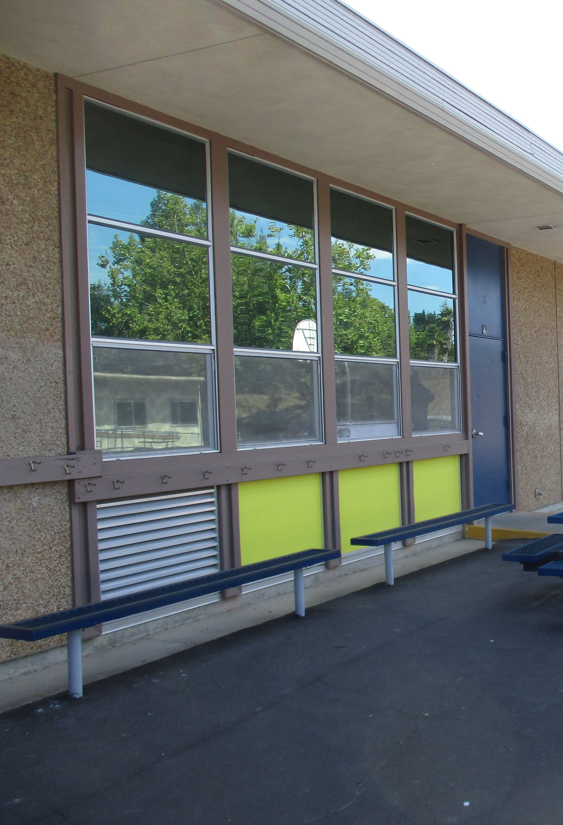
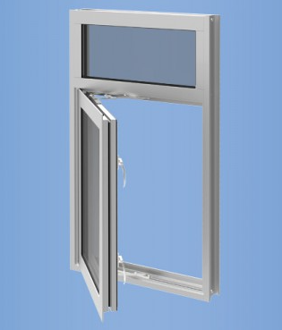
RECOMMENDATIONS – ENVELOPE
Envelope Review
Existing Glazing is single paned glass in a non thermally broken metal framed window system of unknown manufacturer. While in good repair the large window areas with single glazing is allowing a large amount of heat gain into the space and the main point of thermal gain in the existing envelope. The majority of the glass is either West or East facing with limited overhangs. Due to the orientation the gains are early morning or late afternoon with little ability to shade the façade. The roof insulation is minimal, R-19 batt below the deck is estimated based on visual inspection. The wall systems are wood framed and based on the age of the building we’re assuming uninsulated. The smaller metal panels within the window systems (Painted yellow in photo below) were uninsulated but normally behind counter and storage pace on the interior wall Inspection of the wall systems were limited.
Recommendations
Replace the window systems with new insulated low-e glazing in thermally broken framing systems with a U-factor no more than 0.45 and SHGC of 0.25. Casement or other operable windows are recommended for controlling natural ventilation path on days with mild temperatures and good air quality.
When Re-roofing add 4 inches of rigid insulation to the roof deck adding approximately R-20 to the roof deck with Cool Roof coating with minimum aged solar reflectance of 0.63 and thermal emittance of 0.75
When replacing wall surfaces insulate wall systems with minimum R-13 Batt insulation.
Typical Existing Façade
Example of New Low-E Casement Windows

Slide 9
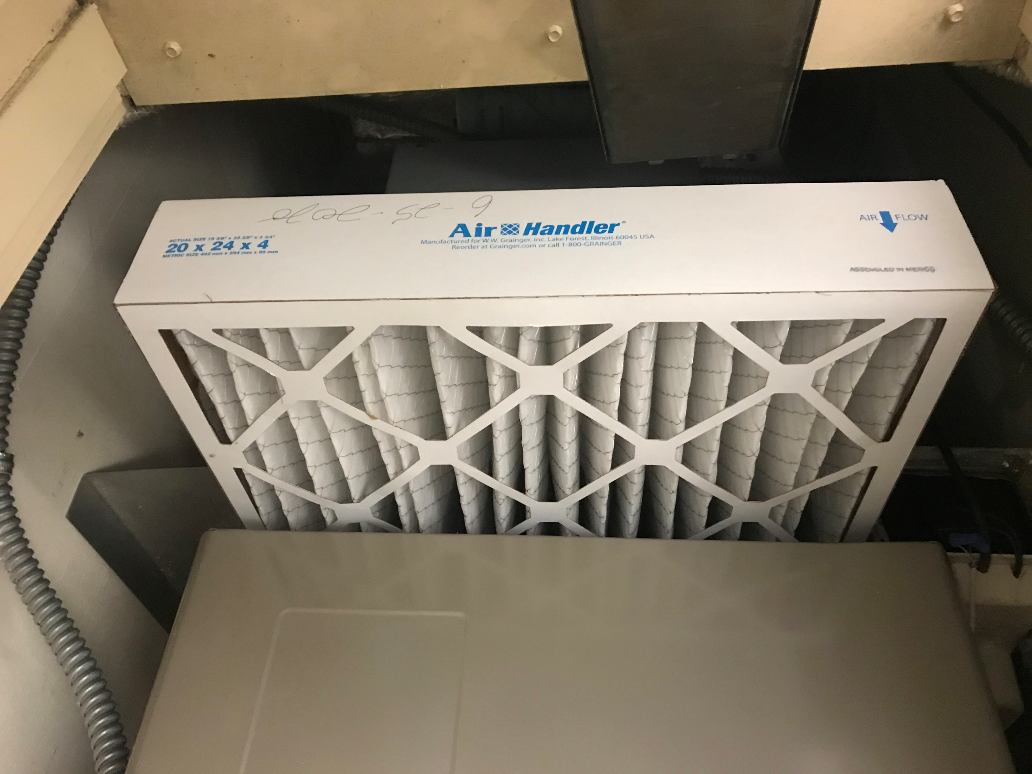
RECOMMENDATIONS – MECHANICAL
Existing Conditions
The existing gas fired condensing furnace units are in good working order and are equipped with motorized outside air dampers scheduled to provide between 450 to 550CFM minimum of outside air to each classroom space with economizer capability. Each unit observed appeared to have newly installed 2” MERV 13 filters in place. Digital programmable thermostats were installed in each classroom observed but since most classrooms were un-occupied due to COVID-19 most thermostats were set to run in “Auto” mode and not continuous operation. When set in “auto” mode once space temperatures are met the unit simply shuts off and no ventilation air is provided. Since no air conditioning is installed there is no opportunity to provide fresh air when in “cooling” mode mechanically. Fresh air would only be supplied during these times from open windows or doors with no filtration.
Level 1 Recommendations:
Recommission all existing classroom furnaces, furnace controls and economizing air dampers/actuators in the mechanical closets to ensure proper operation. There are no air pressure relief measures in the classrooms; therefore, add a barometric relief grille, duct, damper and exhaust cap on roof in each classroom.
Perform an air test and balance by a certified TAB contractor to ensure the appropriate outside, exhaust, return and supply air quantities are met. The contractor should also test the air economizing sequence to ensure for proper operation.
Re-program the existing thermostats to ensure that they continuously operate the furnace supply fans at all times during classroom occupied hours. Currently the fans turn off when temperature setpoints are met or are shut down by local users at the thermostat.
Expand the existing furnace controllers to allow for a night-air-cooling in full economizer mode (classroom air flush) to pre-cool the rooms prior to occupancy for one to two hours and allow a purge sequence at the end of the day to flush out any potential contaminants left in the space for the one to two hour time period.
Typical Gas Fired Furnace Closet & MERV-13 Fresh Filter

Slide 10
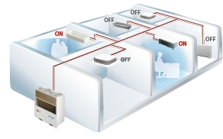
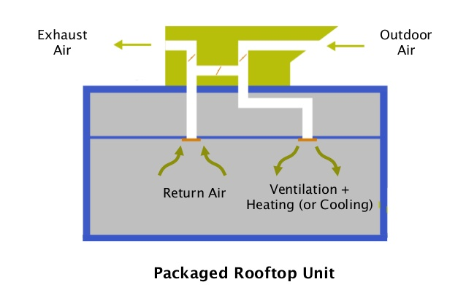
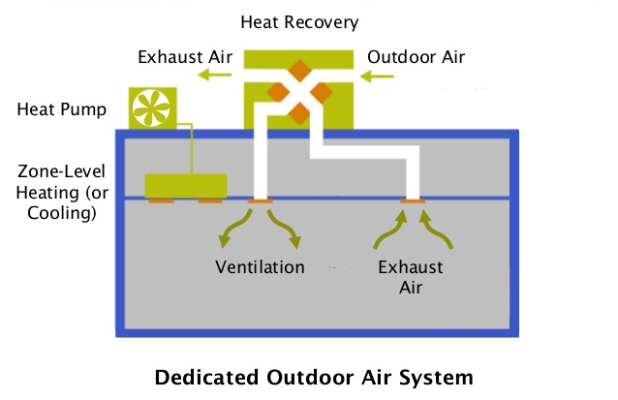
RECOMMENDATIONS – MECHANICAL
Level 2 Recommendations:
Two reasonable options are available for classroom heat mitigation. The intent is to provide tempered (neutral temperature between 65⁰ F. to 70⁰ F.) outside ventilation air introduced into the classrooms. Size equipment for 30% beyond minimum Title-24 Part-6 ventilation requirements and add CO2 sensor controls within the occupied space.
Option 1: Provide Variable Refrigerant Flow (VRF) systems comprising of centrally located outdoor heat pumps at grade level, retrofit direct expansion (DX) vertical coils directly behind the outside air louvers, pre-heated/pre-cooled air temperature sensors and associated refrigerant piping from the heat pumps to the DX coils. This would utilize the existing fresh air pathways and existing HVAC system to enhance space conditioning and outside air flow to the space. This strategy is intended to temper the outside air but not provide full space conditioning in cooling mode. This concept will serve four (4) classrooms with one outdoor unit. These systems have electrical system impacts and would be classified as a Deferred Maintenance project which probably won’t require DSA review.
Option 2: provide packaged Dedicated Outdoor Air Systems (DOAS) units, with or without heat recovery, with MERV-13 or better filters on the roofs centrally located with exposed distribution ductwork to each classroom. These units are designed to heat and cool 100% outside ventilation air to the desired range of neutral air temperatures. This strategy is intended to temper the outside air but not provide full space conditioning in cooling mode. This concept will serve four (4) classrooms with one outdoor unit. These systems will have electrical and structural impacts and will require DSA review and approval. The heat recovery option would be the most efficient option utilizing heat recovery from the exhaust air stream to heat or cool the incoming air. There are no air pressure relief measures in the classrooms; therefore, add a barometric relief grille, duct, damper and exhaust cap on roof or exterior wall in each classroom. This will allow the tempered air quantity introduced into the classrooms from the DOAS units to be relieved to outdoors.
Note: Level 4 is similar in concept but provides a dedicated coil unit for each classroom providing much more robust cooling.
Ground Mounted VRF/VRV Option with Refrigerant Piping to Existing Furnace Closet Typical
Rooftop Dedicated Outside Air Systems

Slide 11
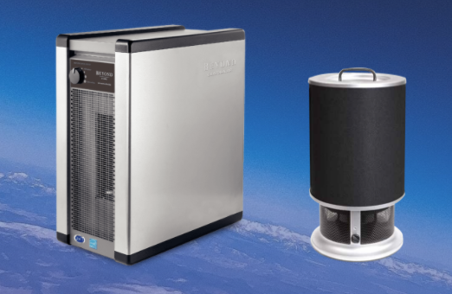
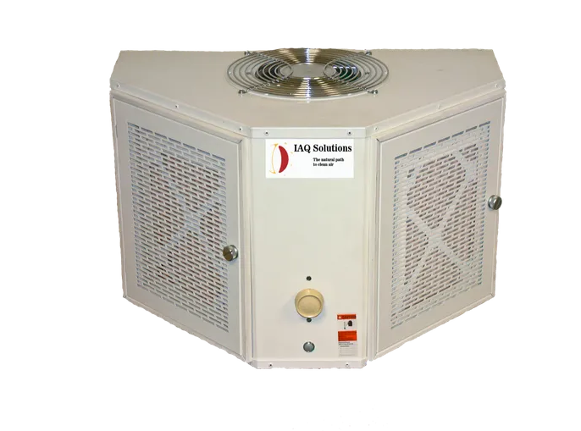
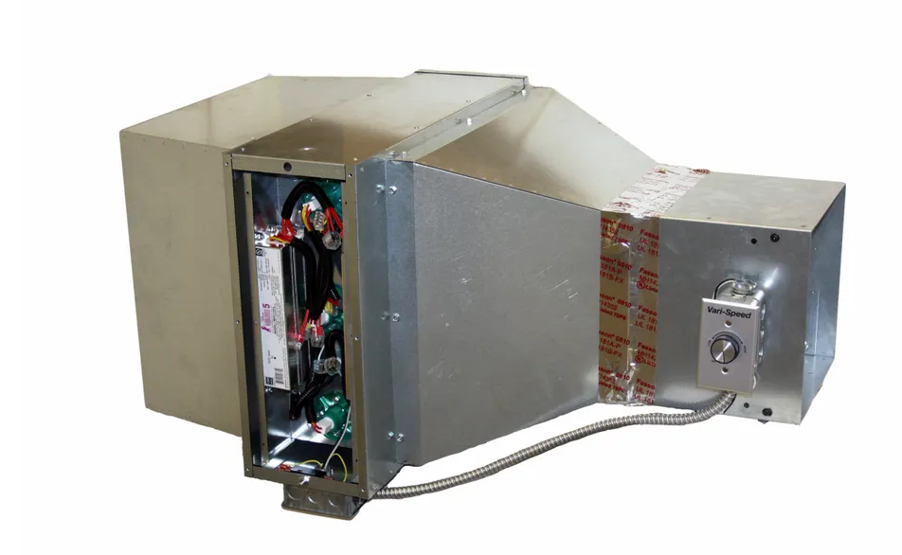
RECOMMENDATIONS – MECHANICAL
Level 3 Recommendations:
Option 1: In addition to the level 2 replacement system, install in room portable HEPA Filtration systems capable of handling the appropriate square footage of the classroom size from 600 SF to 1000 SF. The additional HEPA filtration systems are proven to enhance IAQ in addition to the mitigation measures mentioned in recommendations 1 & 2 on previous pages. This also adds additional comfort level and flexibility of placement within the classrooms near lecture tables and workstations with higher occupant use.
Option 2: Enhanced portable HEPA filters with Ultravioliet light (UVGI) use electromagnetic radiation to destroy bacteria and other pathogens as another means to reduce the risk of virus transmission. Many variations of these products are available on the market currently to further reduce the risk of virus transmission. Examples of these below with either duct mounted systems or room mounted options that use the UVGI. Further testing and balance of the existing systems would be needed to verify if duct mounted options could be implemented with the existing forced air systems but the independent versions could be implemented easily. DO NOT use air cleaning devices that generate harmful pollutants like ionization or ozone generators.
Examples of Stand Alone HEPA Filtration Systems
UVGI Mitigation Duct Mounted Retrofit Kit (https://iaqsolutionsinc.net/products )
Room Mounted UVGI System (https://iaqsolutionsinc.net/products )

Slide 12
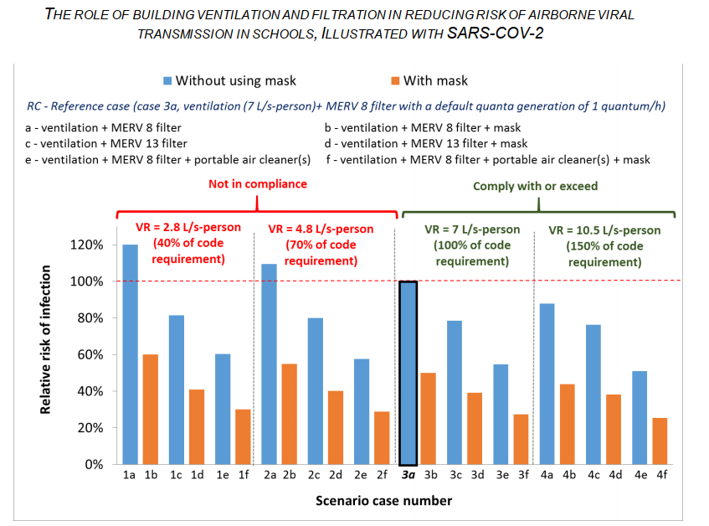
COVID-19 IMPACTS
Technical Review of COVID-19 Mitigation Strategies
While the Science continues on the ways to mitigate COVID-19 in enclosed spaces a handful of tactics are proven facts. Wearing a mask, washing hands, keeping surfaces disinfected all prevent the spread of the Virus. The majority of the spread is from person to person contact and surface, or fomite, transmission. There are various reports linked below with further resources on the topic around airborne transmission and conveyance through the HVAC systems. Throughout these various reports the pattern is similar to these minimum impacts and once established only slight decreases in the rate of transmission are gained going beyond these minimum steps (see Fig.1).
Establish current code required minimum outside air rates to each space on a continuous basis.
Establish MERV-13 filters at a minimum and replace filters on a regular basis.
Either increase outside air to the space or add portable HEPA filtration within the space. DO NOT use air cleaning devices that generate harmful pollutants like ionization or ozone generators.
CA Department of Public Heatlh and COVID-19 Protection
https://www.cdph.ca.gov/Programs/CCDPHP/DEODC/EHLB/IAQ/CDPH%20Document%20Library/IAQ%20paper%20on%20school%20ventilation%20filtration%20viral%20transmission.pdf
Figure 1: CA Department of Public Health Mitigation Strategies*
ASHRAE: Detailed Guidance for Reopening Schools https://www.ashrae.org/file%20library/technical%20resources/covid-19/ashrae-reopening-schools-and-universities-c19-guidance.pdf
*Not outlined in this study but supported by the authors a virus transmission risk reduction of just over 30% for portable HEPA Filters with MERV-13 filters in a room designed with minimum ventilation air provided to the space.

Slide 13
POTENTIAL SCOPE PACKAGES AND COST ESTIMATES
OPTION 1 – SIMPLE AND STRAIGHTFORWARD
Item 1 - New High Reflective Roof and Insulation $1,031,000
Item 2 (Level 3) – Portable Filtration System $ 61,000
Item 2 (Level 4) - Mechanical System with PGE Service Upgrade $ 700,000
Total Estimated Construction Cost: $1,792,000

Slide 14
POTENTIAL SCOPE PACKAGES AND COST ESTIMATES
OPTION 2 – PASSIVE MEASURES
Item 1 - New High Reflective Roof and Insulation $1,031,000
Item 2 (Level 1) – Portable Filtration System $ 61,000
Item 2 (Level 3) – Mechanical Improvements $ 136,000
Item 3 – Heat Reflective Coating for AC Paving $ 229,000
Item 4 – Planting $ 35,000
Item 5 (Level 2) – Envelope Improvements $ 123,000
Item 6 – Irrigation $ 26,000
Total Estimated Construction Cost: $1,641,000

Slide 15
POTENTIAL SCOPE PACKAGES AND COST ESTIMATES
OPTION 3 – ALL IN
Item 1 - New High Reflective Roof and Insulation $1,031,000
Item 2 (Level 4) – Mechanical System Improvements $ 700,000
Item 2 (Level 3) – Heat Reflective Coating for AC Paving $ 61,000
Item 4 – Planting $ 35,000
Item 5 (Level 2) – Envelope Improvements $ 848,000
Item 6 – Irrigation $ 26,000
Total Estimated Construction Cost: $2,808,000

Slide 16
CONCLUSIONS
Heat Mitigation: The primary goal of this study was to investigate heat mitigation in the building. The simple measures of painting the surfaces of the building with reflective materials on the roof, walls, and door panels will reduce the collection of heat gain within the spaces. The environmental surfaces of the parking lots, concrete, and even dry grass collect significant amounts of heat that warm the surfaces and exacerbate the microclimate around the building. Painting the play surfaces and parking lots with reflective pavement coatings have proven to drop environmental temperatures by nearly 10 degrees in some climates. Enhancing shading with trees and other vegetation enhances the cooling effect with plant transpiration, passive cooling, as well as adding healthier air with plant CO2 to oxygen transformation.
Adding insulation to the roof and walls as noted when doing capital improvements will further mitigate heat gain into the space. The glazing systems will need to be replaced as they fail at end of life and should be replaced with high performance low-e glass. Retaining the natural ventilation paths will enhance IAQ and flexibility with the climate on mild days.
HVAC Improvements and COVID Mitigation: The three levels of mitigation measures recommended allow for measured improvements in both IAQ and virus risk mitigation strategies. The first is bringing IAQ to current code levels with re-establishing fresh air systems and maintaining constant airflow through the MERV-13 filters. That first step is the most important according to the CA Department of Public Health. Adding cooling to the fresh air stream in either of the proposed options in recommendation level 2 will start to address thermal comfort in the spaces on hot days. Since there is no cooling system attributed to the existing classrooms the recommendations in level 2 will address both fresh air and comfort cooling. The third level of air quality introduces portable HEPA filtration and enhanced UVGI virus mitigation which is the third tier of virus infection risk mitigation. With each of the level tiers of recommendations there are increasing costs with diminishing virus mitigation potential. As with any of these recommendations there is no implied guarantee of complete virus mitigation as the bulk of the research suggests fomite (surface) transmission is more likely than aerosol transmission through room air once minimum outside air and MERV-13 filters are established. Each of these recommendations reduce the likely transmission of viruses but cannot guarantee full protection.
NEXT STEPS:
Once the district’s preferred approach and scope has been identified QKA and our consultants will prepare a proposed fee and schedule for design services for the implementation of the proposed work. Part of those services will be to perform a detailed energy model to confirm the impact of these improvements will meet the minimum standard for thermal comfort inside the classrooms.

Slide 17
THE END?

Slide 18
COST ESTIMATE FOR REFERENCE
Gravenstein Union School District Hillcrest Middle School Heat Mitigation Study |  | Date: |  |  | Preliminary Estimate Draft 5-Nov-20
BUDGET SUMMARY
IMPROVEMENT ITEM | Construction Cost (excluding | Level 1 Construction Cost | Level 2 Construction Cost | Level 3 Construction Cost | Level 4 Construction Cost Comments
 | markups) | with mark-ups | with mark-ups | with mark-ups | with mark-ups
1 New High Reflective Roof and Insulation | $687,800 | $1,030,600
2 Mechanical Improvements
Level 1: Mechanical Improvements | $90,578 | $135,721
Level 2: Option 1 - Mechanical Improvements | $407,250 |  | $610,223
Level 2: Option 2 - Mechanical Improvements | $513,700 |  | $769,728
Level 3: Option 1 -Mechanical Improvements | $40,725 |  |  | $61,022
Level 3: Option 2 - Mechanical Improvements | $94,595 |  |  | $141,741
Level 4: Option 1 - Mechanical Improvements | $467,250 |  |  |  | $700,127
3 Heat Reflective Coatings For The AC Paving Areas | $152,883 | $229,079
4 Planting Along The East and West Walkway | $23,608 | $35,373
5 Envelope Improvements
Level 1: Envelope Improvements | $82,021 | $122,900
Level 2: Envelope Improvements | $565,953 |  | $848,024
6 Irrigation For West Side Hill | $17,400 | $26,072

Slide 19
POTENTIAL SCOPE PACKAGES AND COST ESTIMATES
OPTION 1 – SIMPLE AND STRAIGHTFORWARD
Item 1 - New High Reflective Roof and Insulation $1,030,600
Item 2 (Level 4) - Mechanical System with PGE Service Upgrade $ 700,127
Total Estimated Construction Cost: $1,730,727
OPTION 2 – PASSIVE MEASURES
Item 1 - New High Reflective Roof and Insulation $1,030,600
Item 2 (Level 1) - Mechanical System $ 135,721
Item 3 – Heat Reflective Coating for AC Paving $ 229,079
Item 4 – Planting $ 35,373
Item 5 (Level 2) – Envelope Improvements $ 122,900
Item 6 – Irrigation $ 26,072
Total Estimated Construction Cost: $1,579,745
OPTION 3 – ALL IN
Item 1 - New High Reflective Roof and Insulation $1,030,600
Item 2 (Level 4) - Mechanical System $ 700,127
Item 3 – Heat Reflective Coating for AC Paving $ 229,079
Item 4 – Planting $ 35,373
Item 5 (Level 2) – Envelope Improvements $ 848,024
Item 6 – Irrigation $ 26,072
Total Estimated Construction Cost: $2,869,275

